Slide 1



Project no.
Project Proposal
Title: CoinBiz
Jirah Joy Medina
Powered by

Slide 2


Project Description
Briefly introduce the project
CoinBiz is a platform that provides news, information and real time prices about Bitcoin and cryptocurrencies.
Who is the target end user?
Traders (beginner and advance)
What are the objectives?
To provide crypto prices and list of available coins invest
To provide latest news on cryptocurrencies and business world
To provide guidance for beginners who wants to start their journey in cryptocurrencies.
Powered by

Slide 3
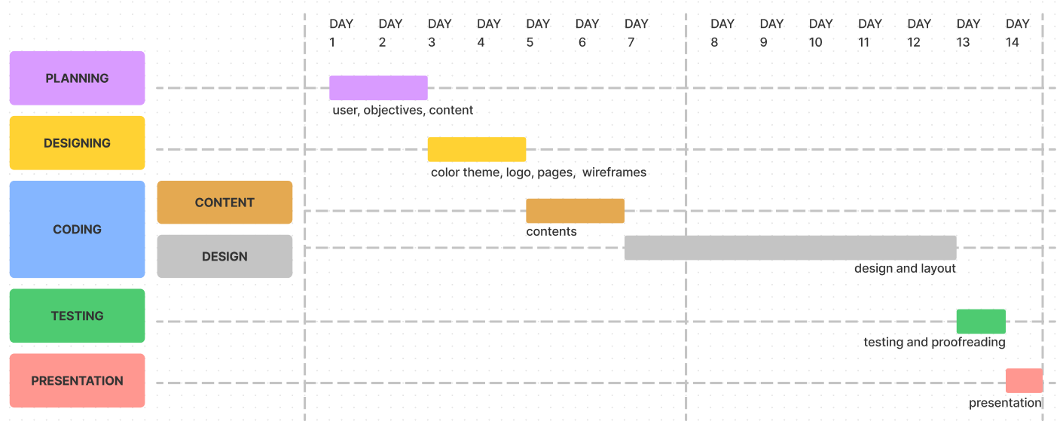
Define Deliverables and Goals
Powered by

Slide 4
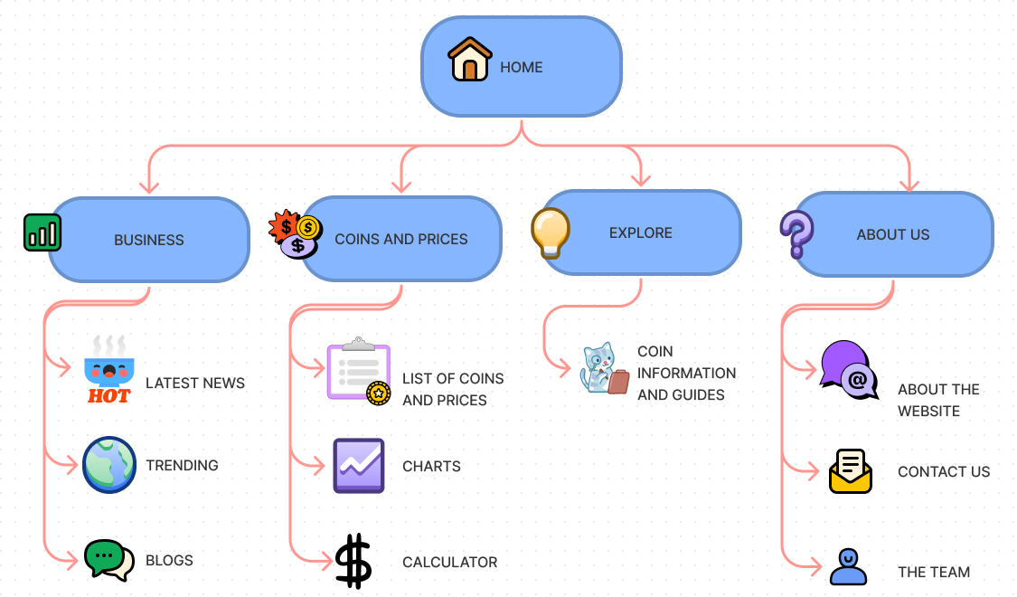
Hierarchical Sitemap of your Website
Powered by

